Slide 1
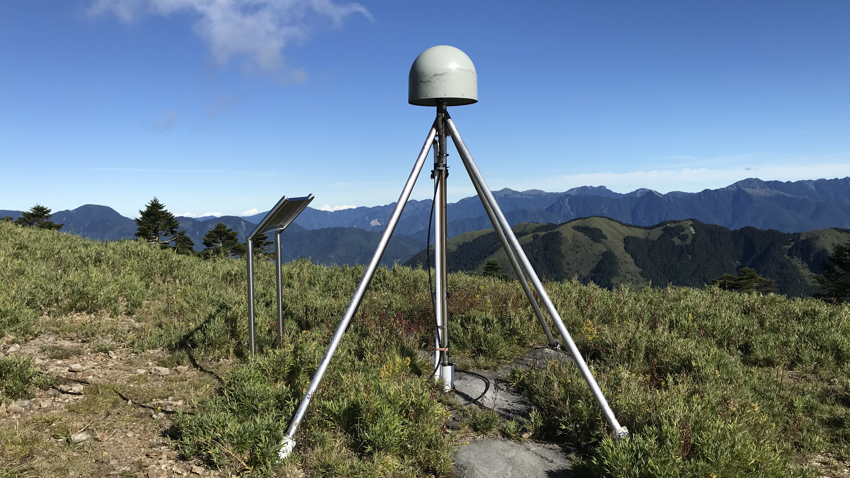


大地測量資料庫
童 忻
Hsin Tung
中央研究院 地球科學研究所
Academia sinica Institute of Earth Sciences

Slide 2
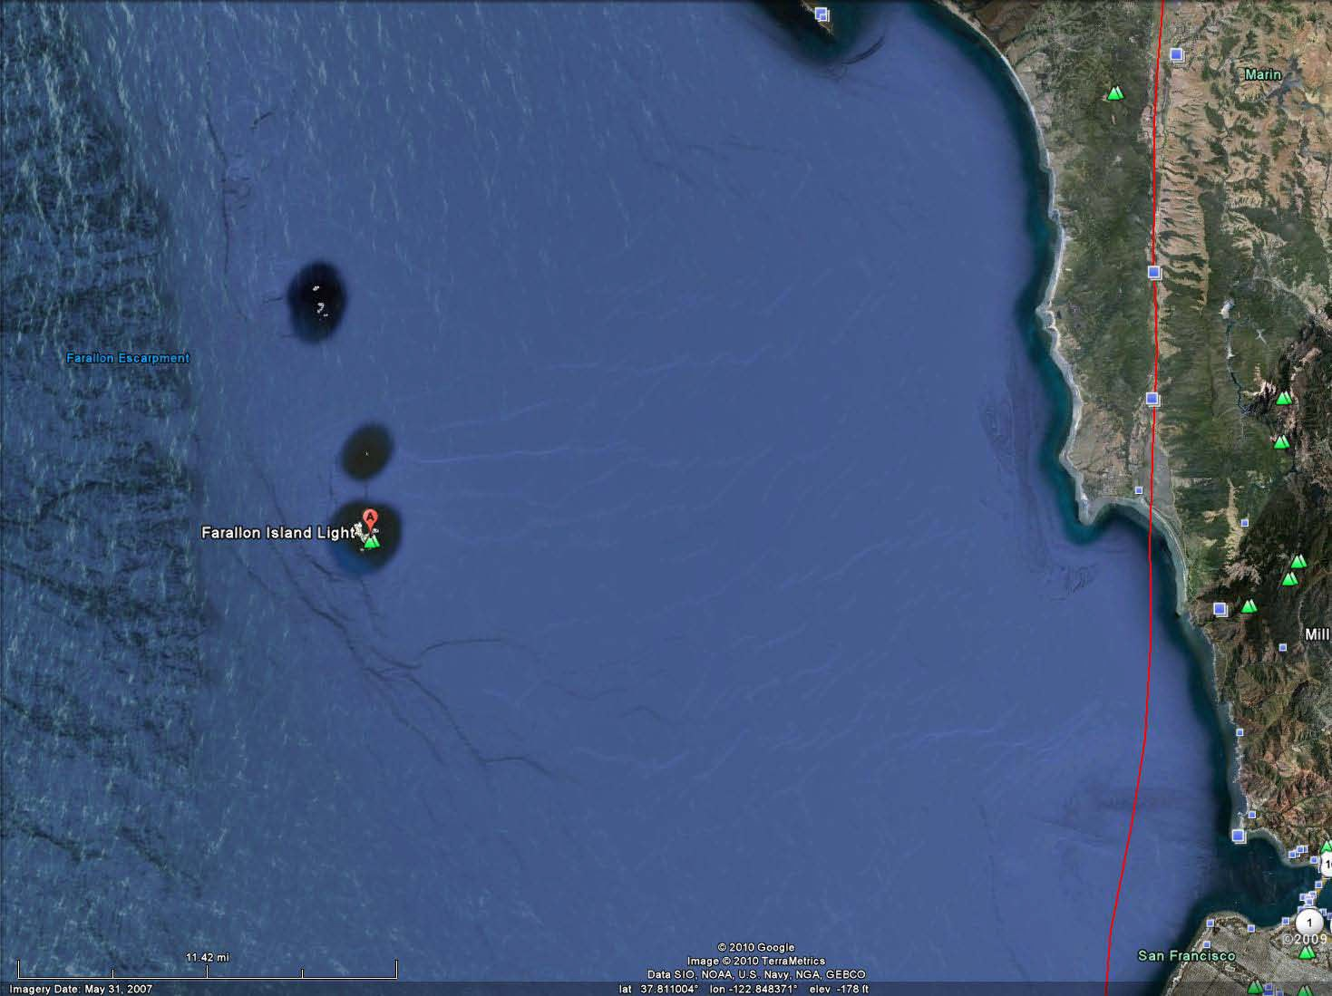
How to measure Earth’s surface (change)?
Courtesy of Ray Y. Chuang

Slide 3
Courtesy of Ray Y. Chuang

Slide 4
Courtesy of Ray Y. Chuang

Slide 5
Courtesy of Ray Y. Chuang

Slide 6
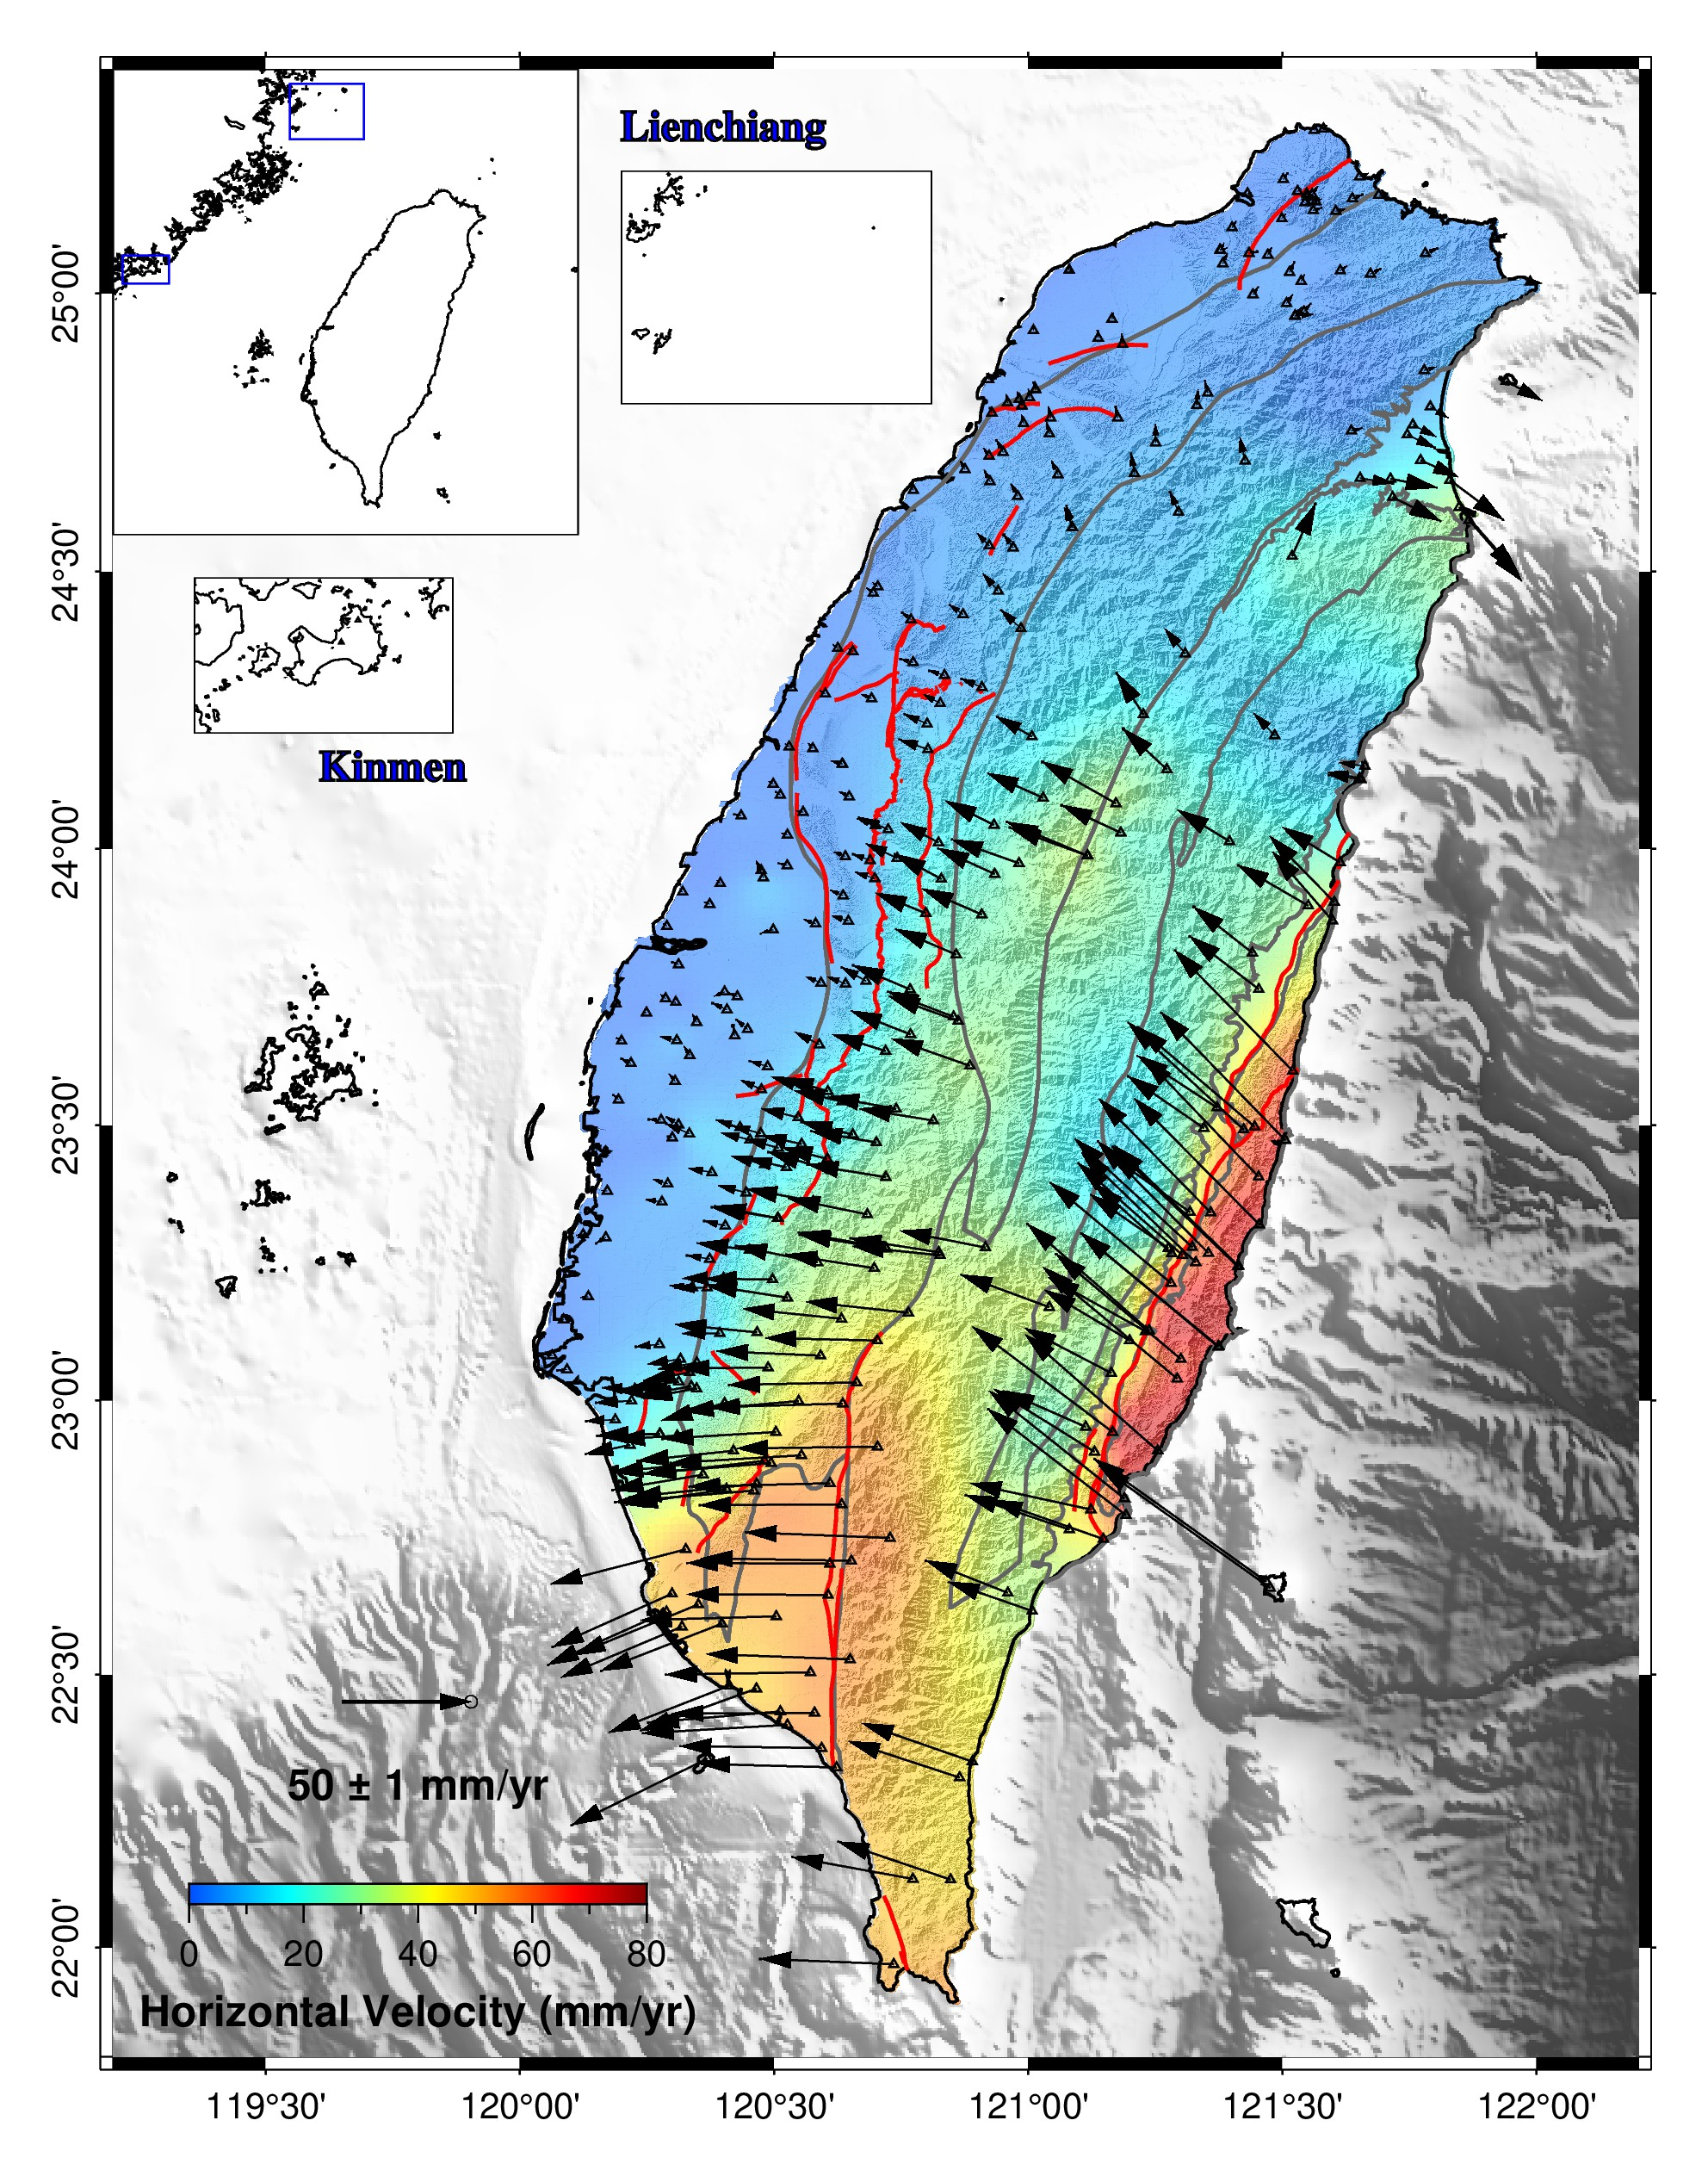
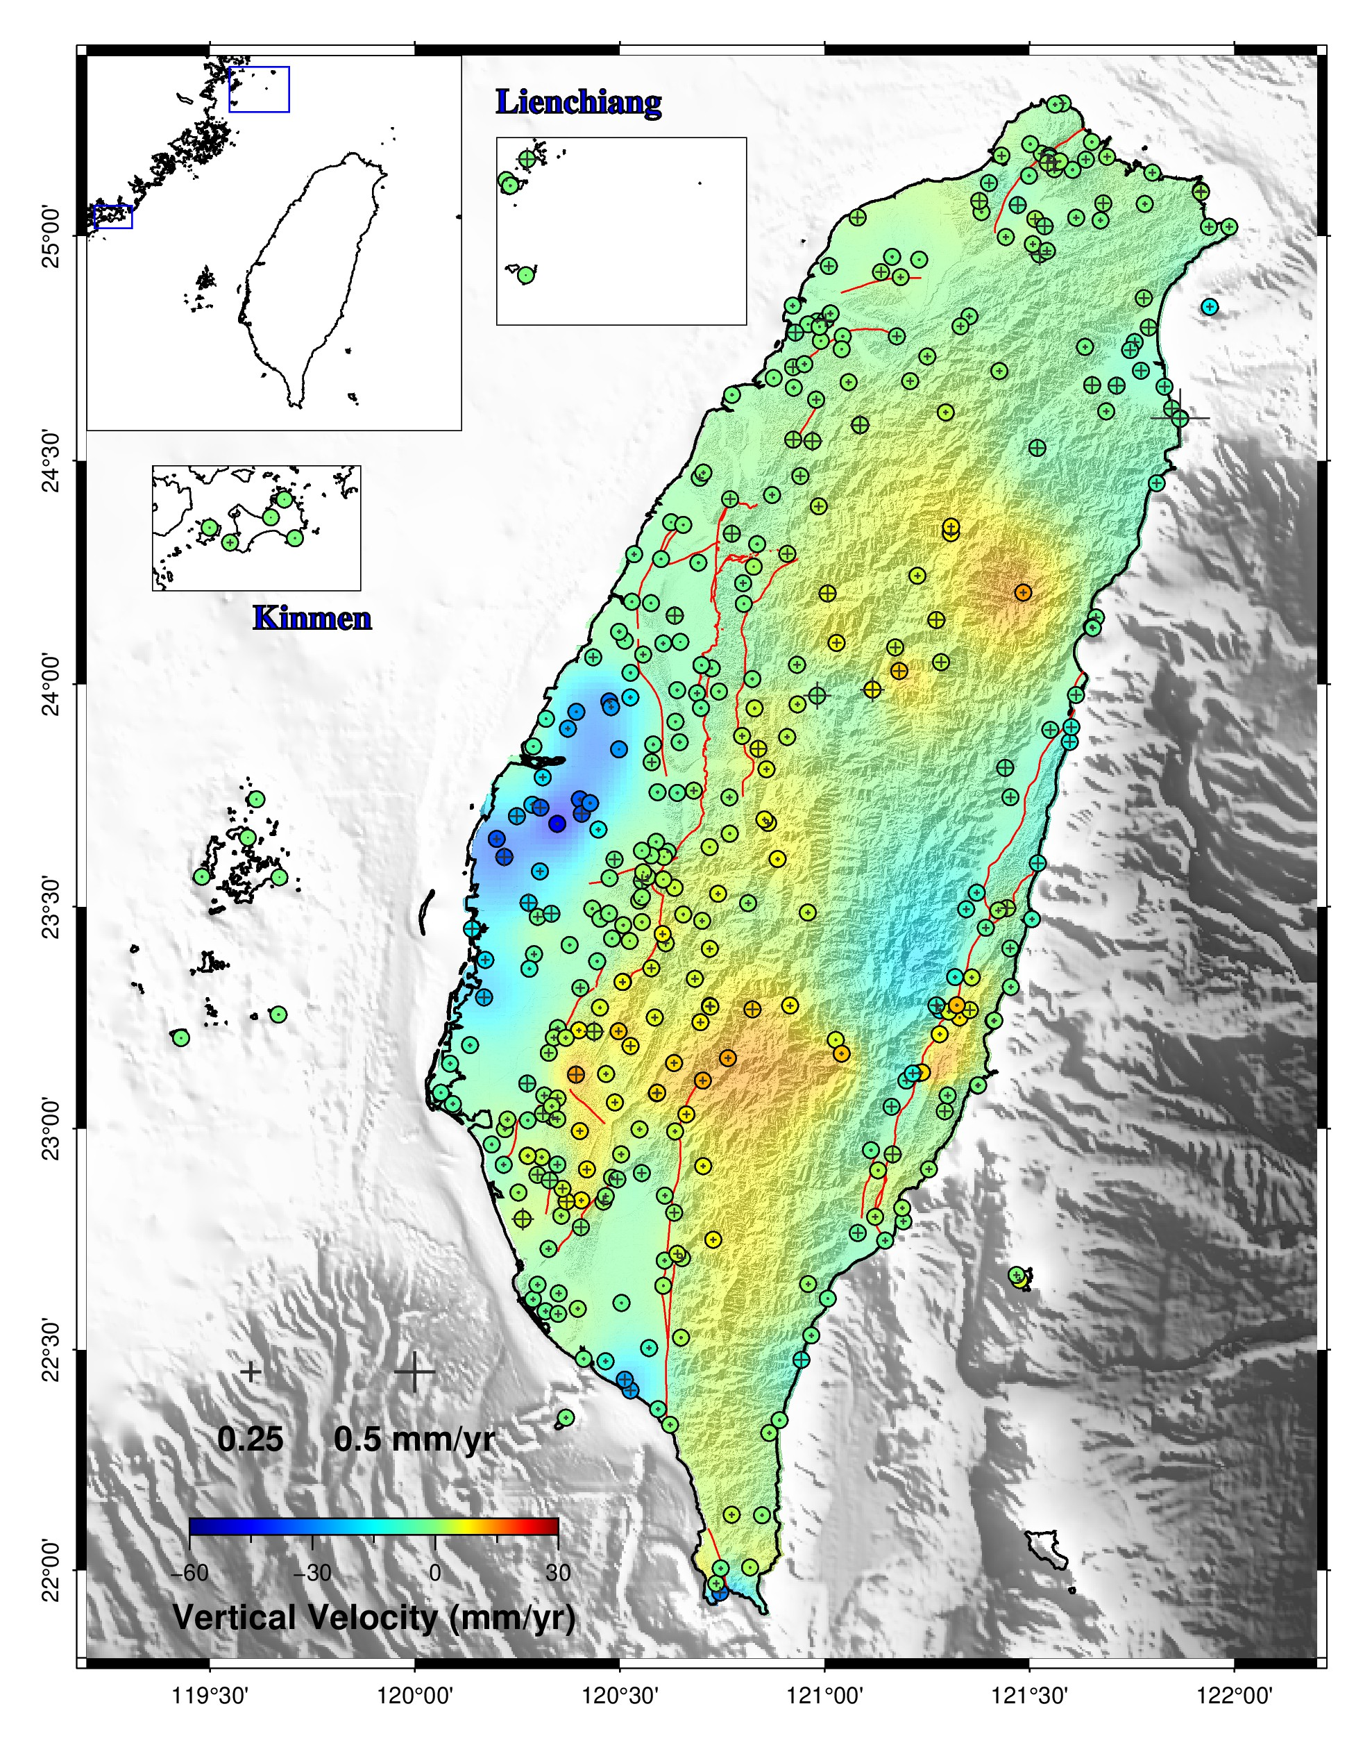
Velocity Field (2010-2025)

Slide 7
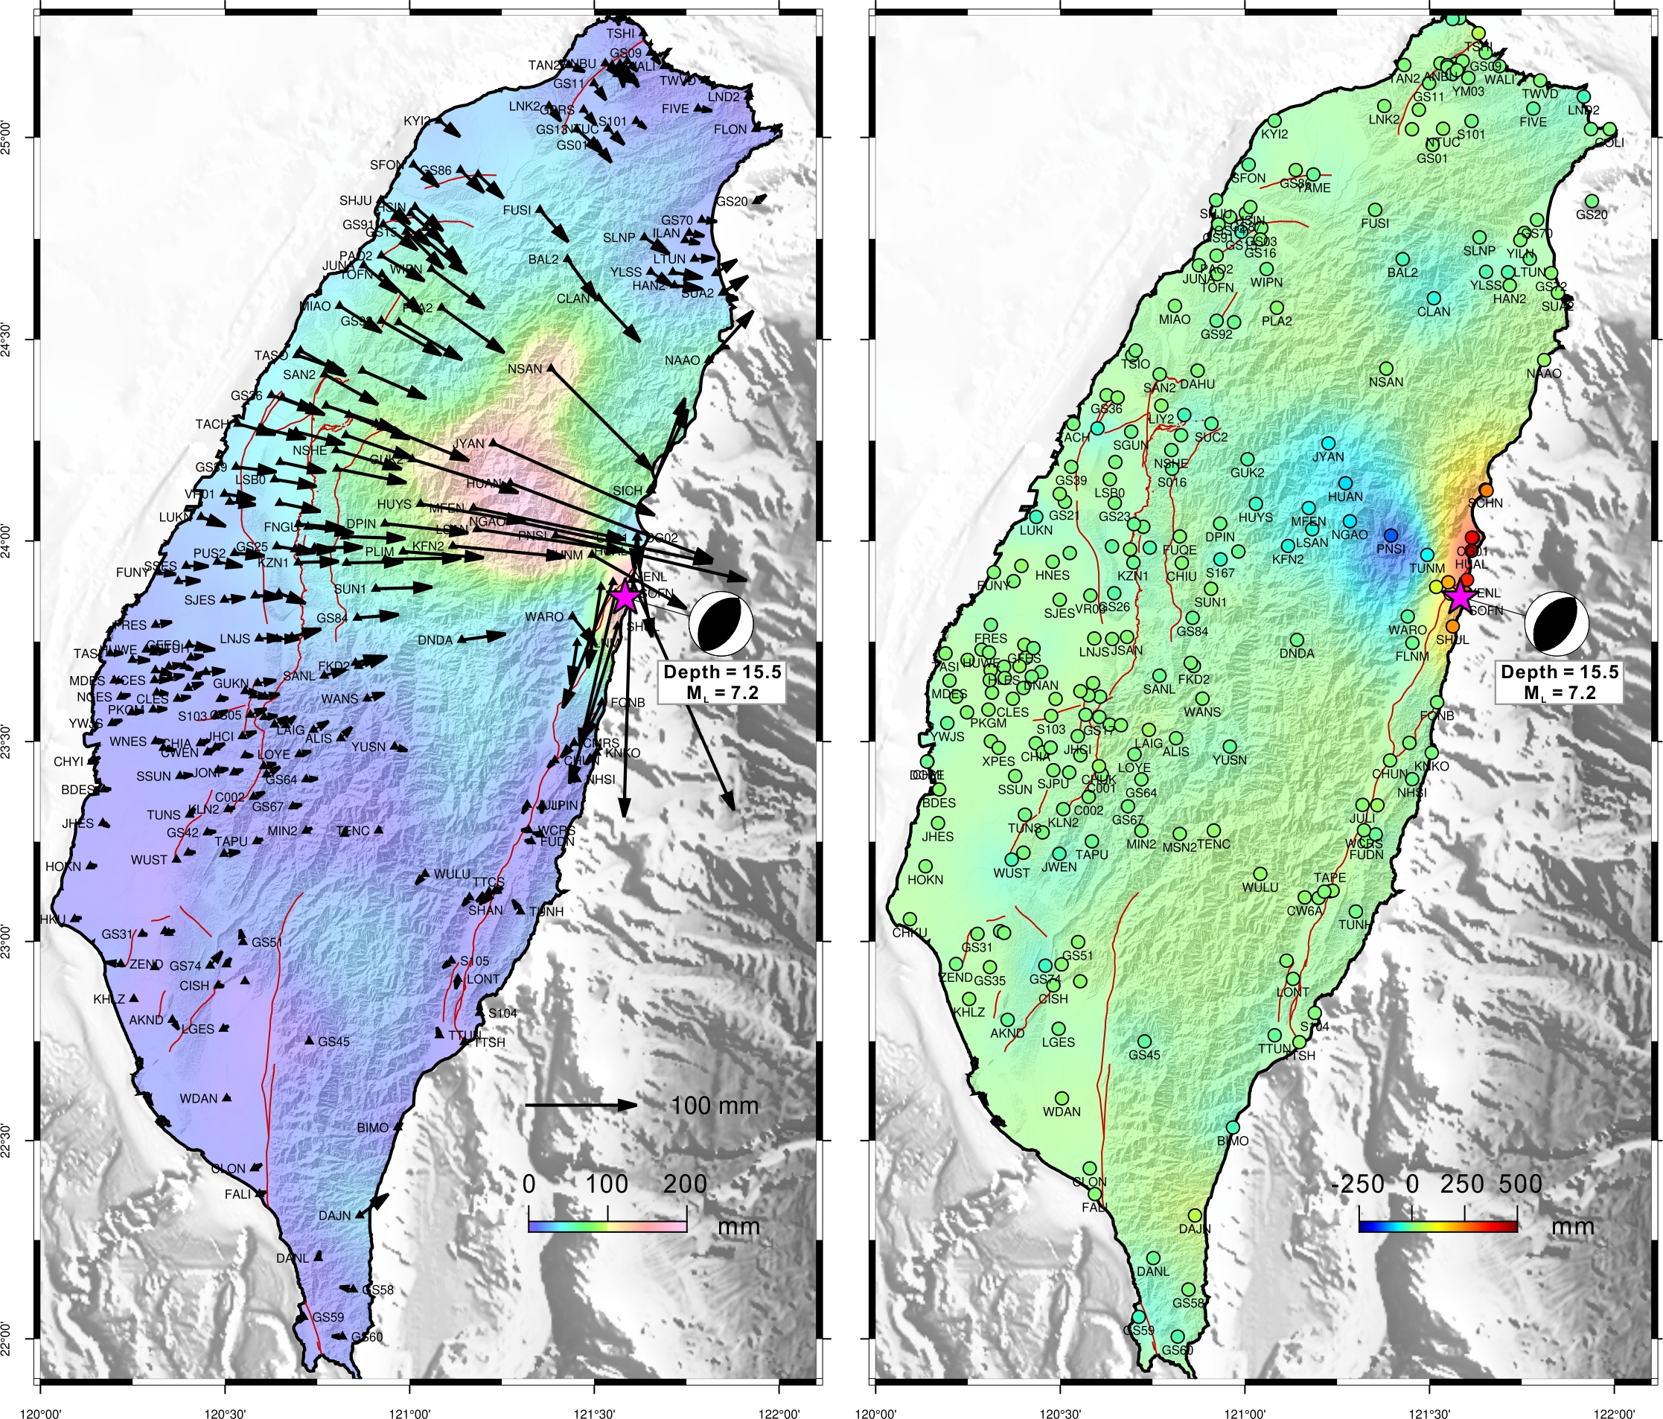
Coseismic displacement (2024/04/03 event)

Slide 8
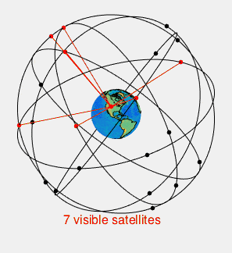
What is GPS?
The global positioning system is a satellite-based navigation system consisting of a network of 24 orbiting satellites that are eleven thousand nautical miles in space and in six different orbital paths. The satellites are constantly moving, making two complete orbits around the Earth in just under 24 hours.
wikipedia
The GPS project was started by the U.S. Department of Defense in 1973. The first prototype spacecraft was launched in 1978 and the full constellation of 24 satellites became operational in 1993.
Originally limited to use by the United States military, civilian use was allowed from the 1980s.

Slide 9
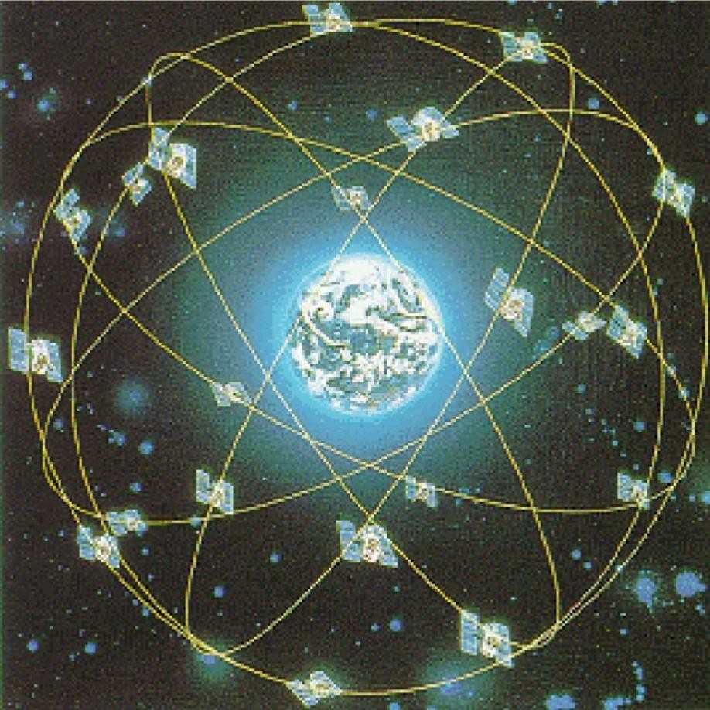
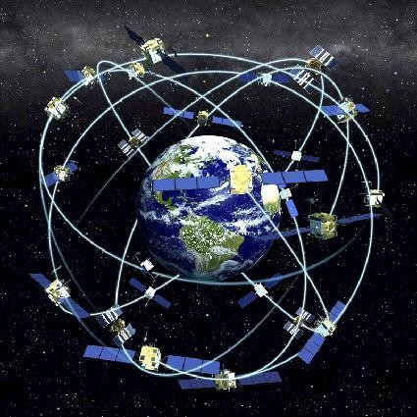
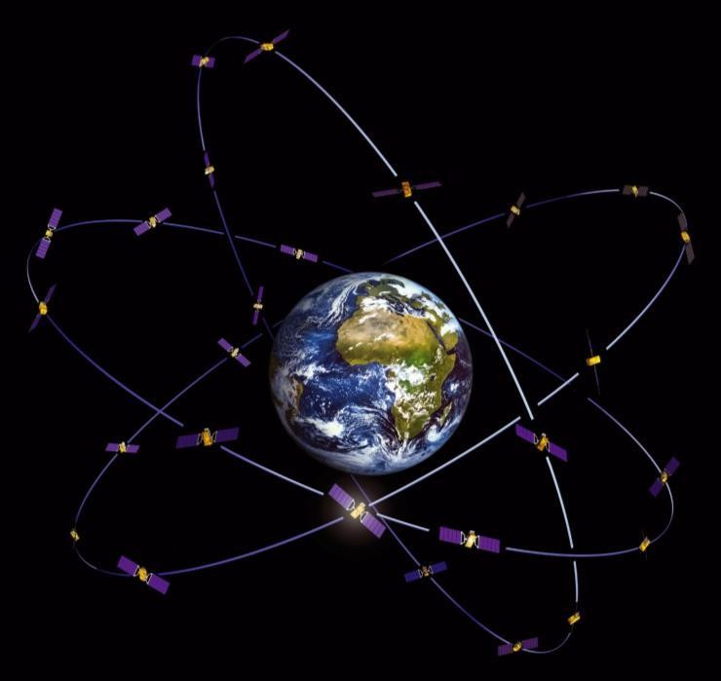
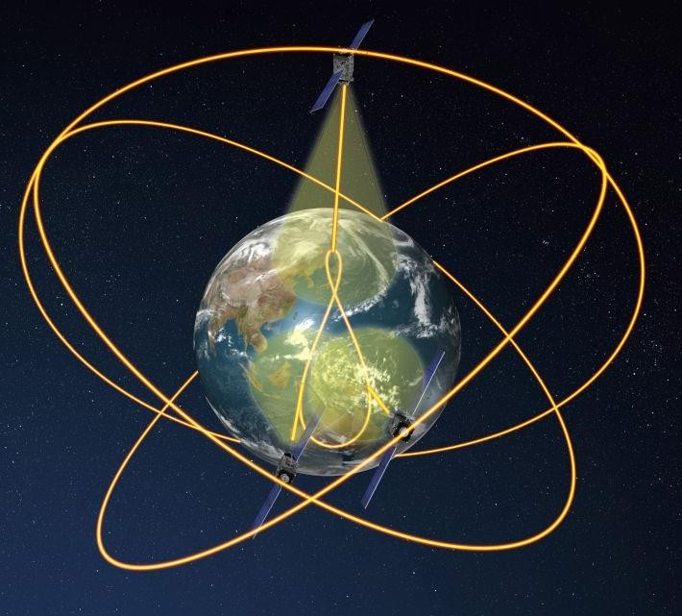

GNSS : Global Navigation Satellite System
GPS (USA)
GLONASS (Russia)
Galileo (EU)
QZSS (Japan)
Beidou (China)
Not only GPS !

Slide 10
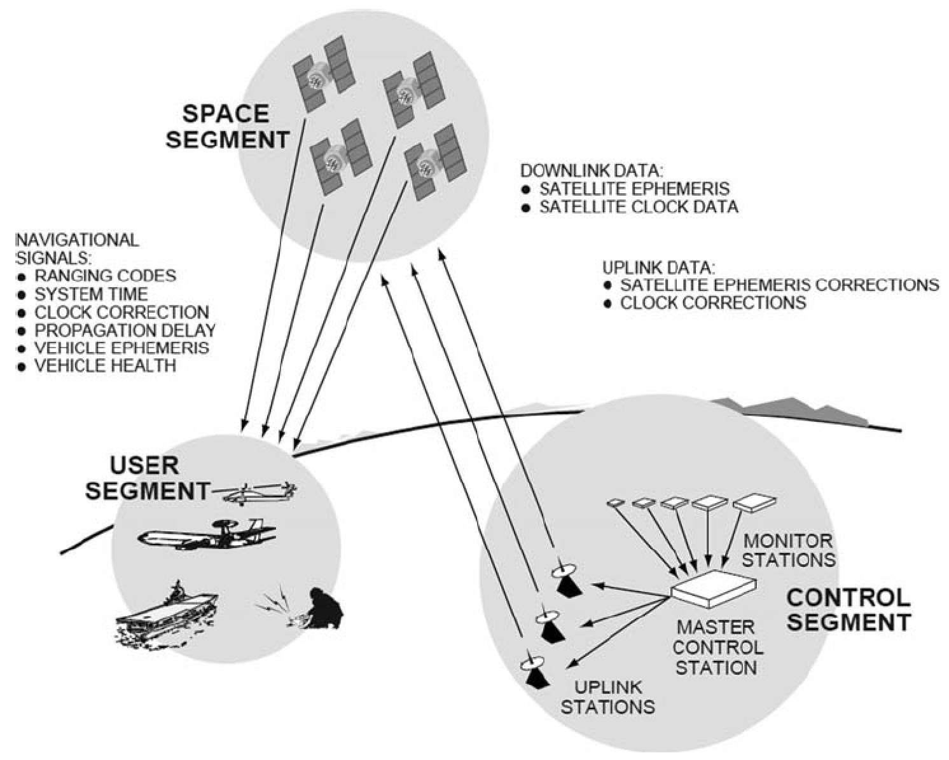
The GPS System

Slide 11
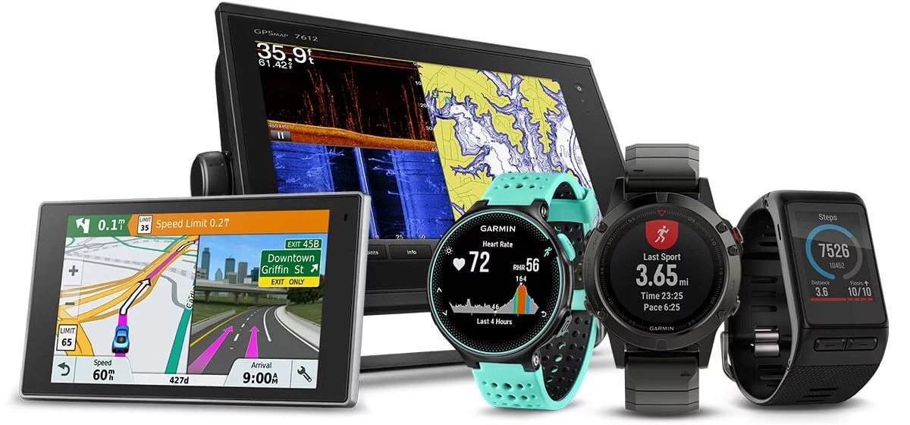
GPS User Segment
3 – 10 K NTD 30 – 100 K NTD > 200 K NTD
5 – 10 m <1- 10 m 1 mm to 1 cm

Slide 12
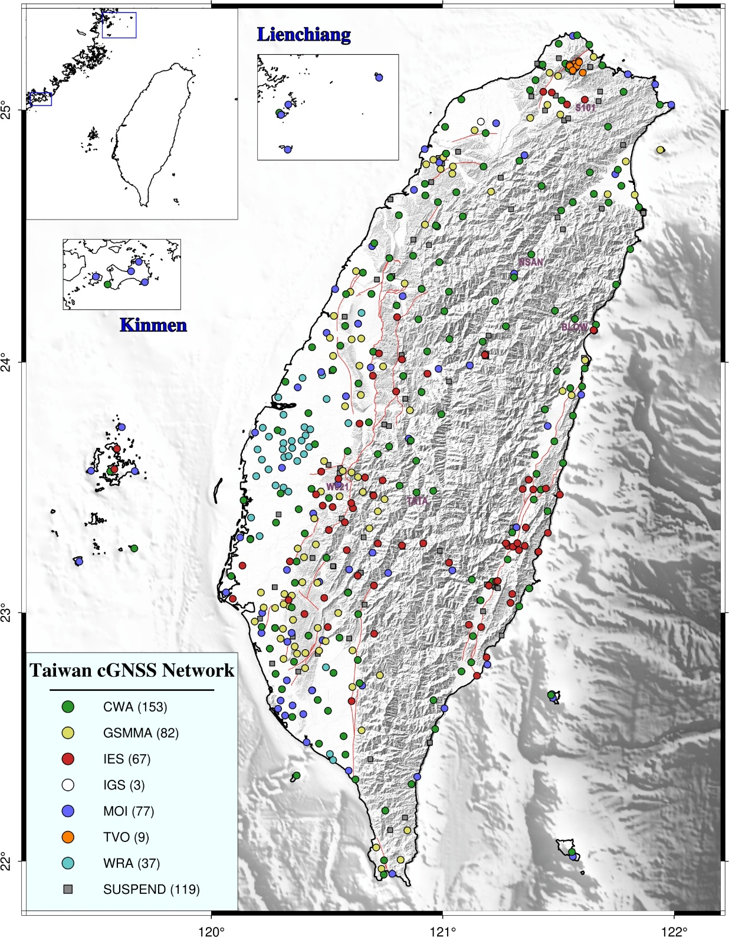
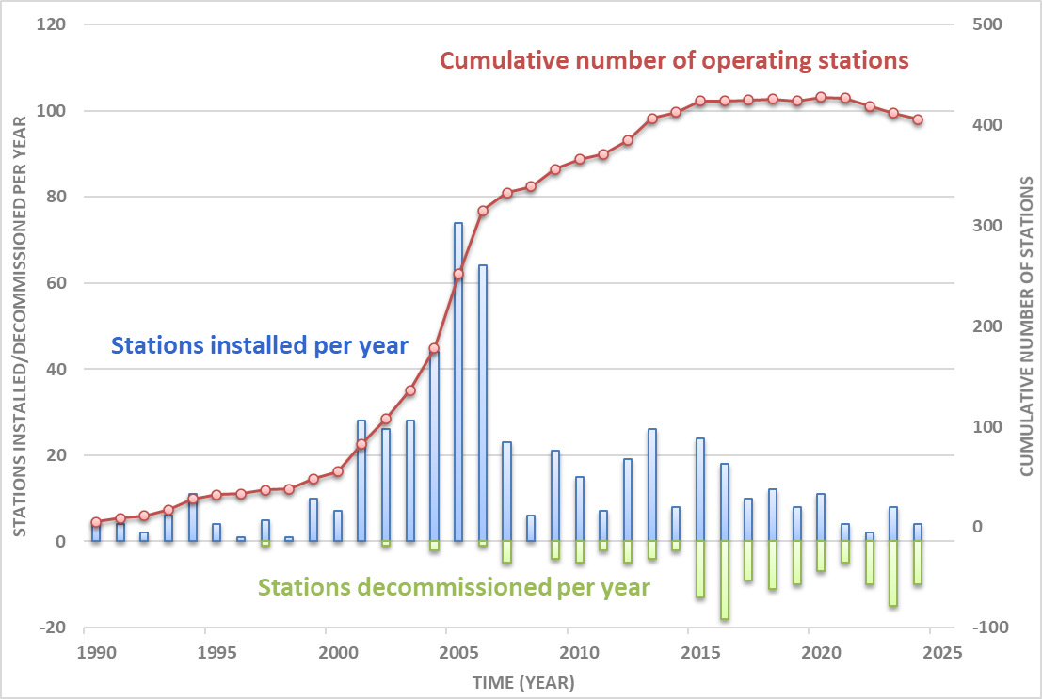
Taiwan GNSS Array
Since 1990
Total : 540+
Working : 400+
CWA 中央氣象署
GSMMA 地礦中心
IES 中央研究院
MOI 國土測繪中心
TVO 大屯火山觀測站
WRA 水利署

Slide 13
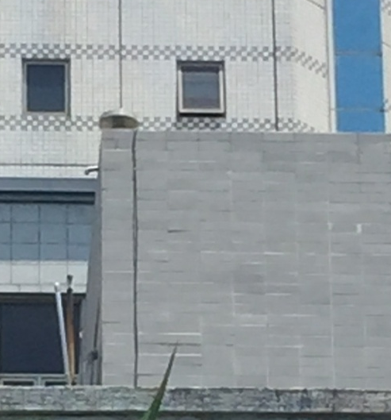
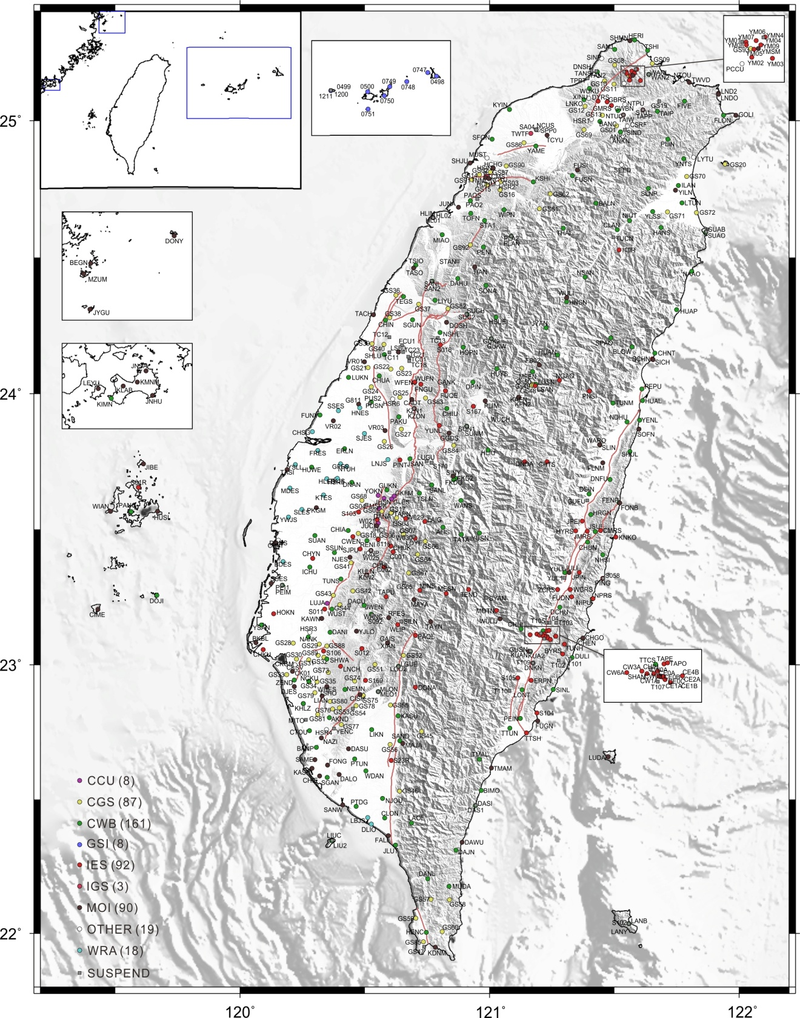
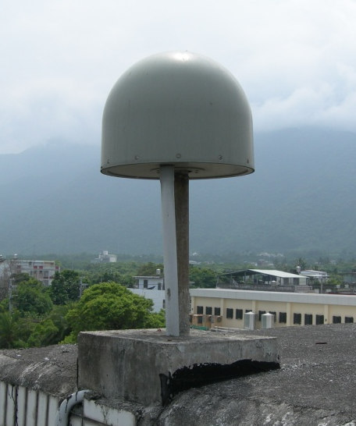
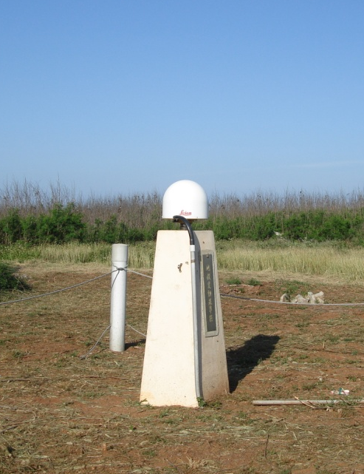
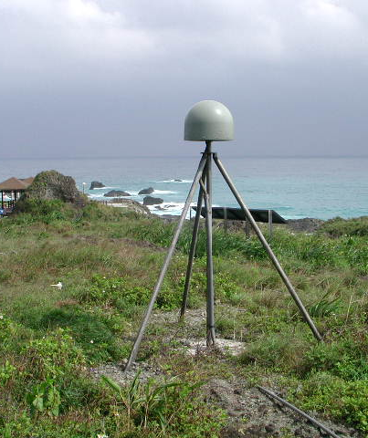
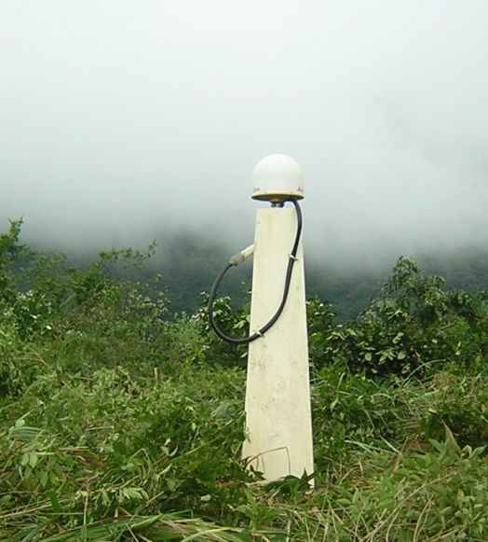
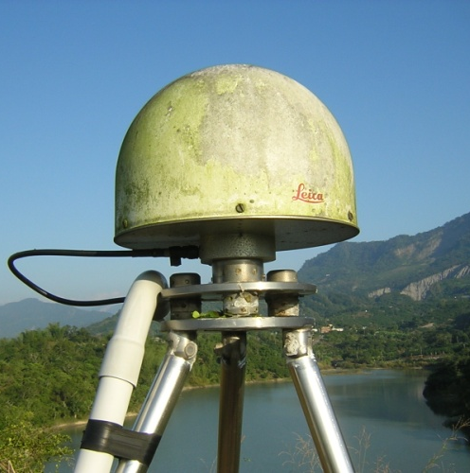
NTUC
SCHN
S01R
KNKO
S105
S012
operational
GPS stations

Slide 14
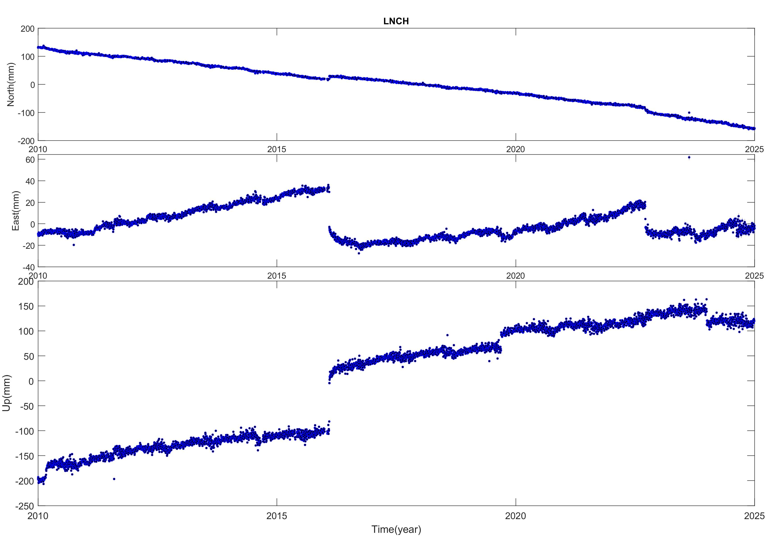
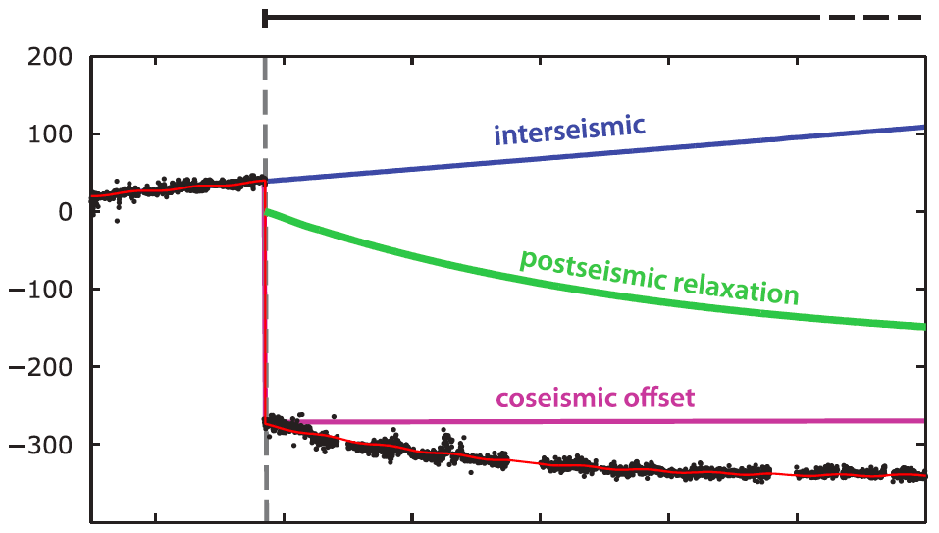
GPS Time Series
1. Interseismic motion
2. Coseismic displacement
3. Postseismic displacement
4. Fault transients
5. Seasonal motion
( fault creep, water cycle, slow‐creeping landslide,
vegetation change, etc. )
(Rousset et al,. 2012)

Slide 15
Position & Linear Rate
Annual and semi-annual periodic motion
offsets
Exponential decay
Errors
(Nikolaidis et al., 2001)
n : daily solution epochs in units of years
b : linear rate during inter-seismic period
c.d.e.f : amplitude of annual and semi-annual motions
g : offsets (including coseismic displacements and antenna changes)
h : post-seismic represent as exponential decay with magnitude
H : Heaviside step function
τ : relaxation time.
T_{j} : selected earthquake epochs
v_{i} : error

Slide 16

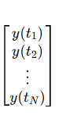
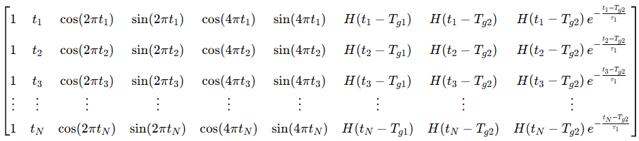
GPS Time Series in Matrix Form (d = Gm)
參數向量
d = m G
觀測向量
設計矩陣
=

Slide 17
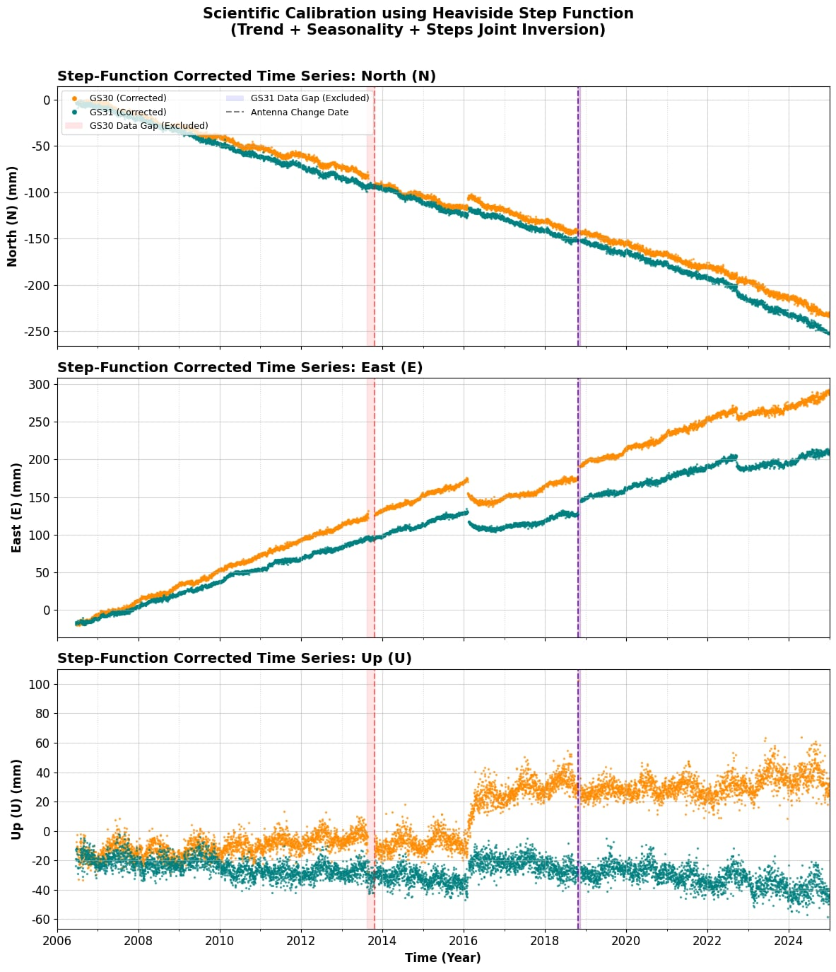
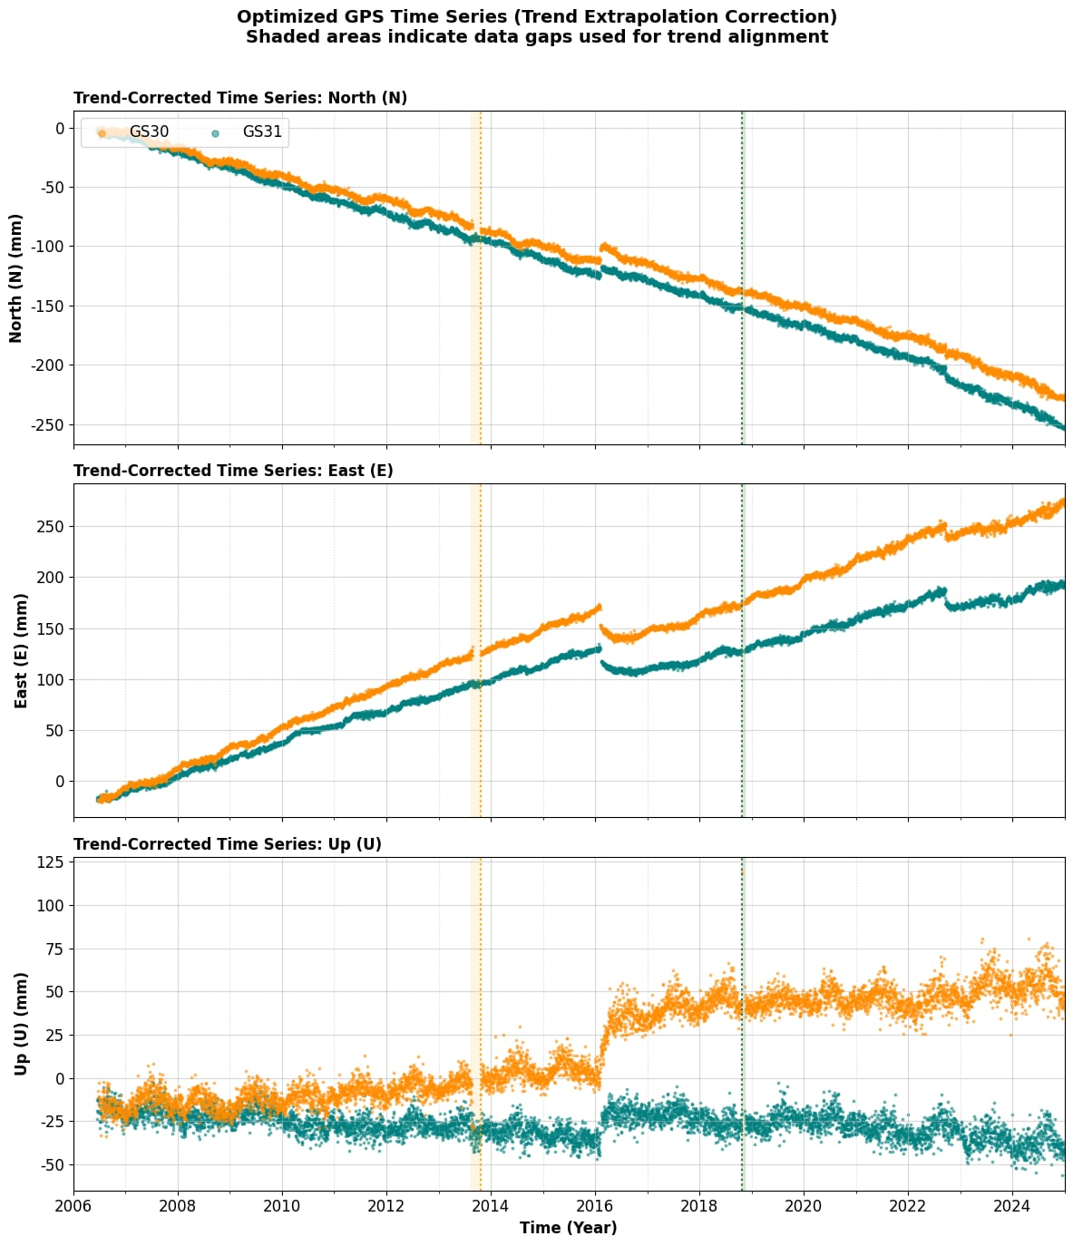

Slide 18
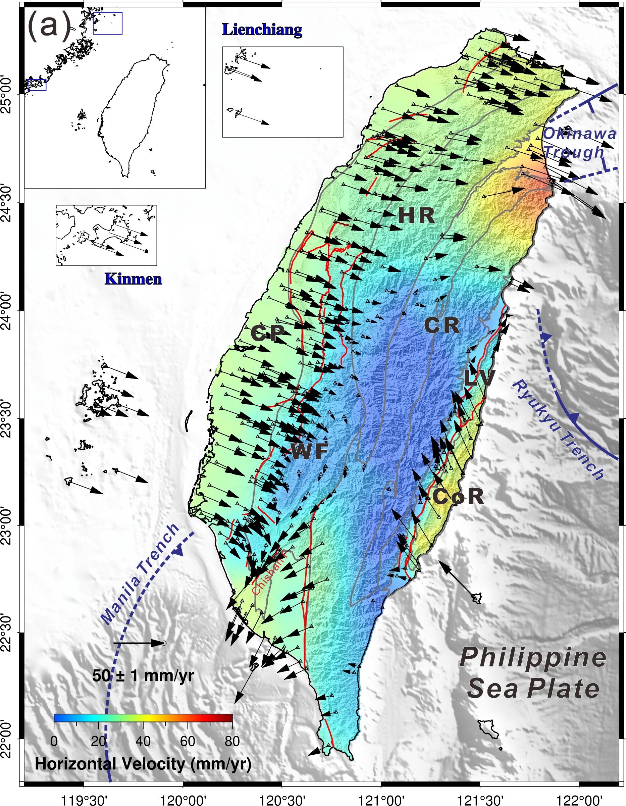
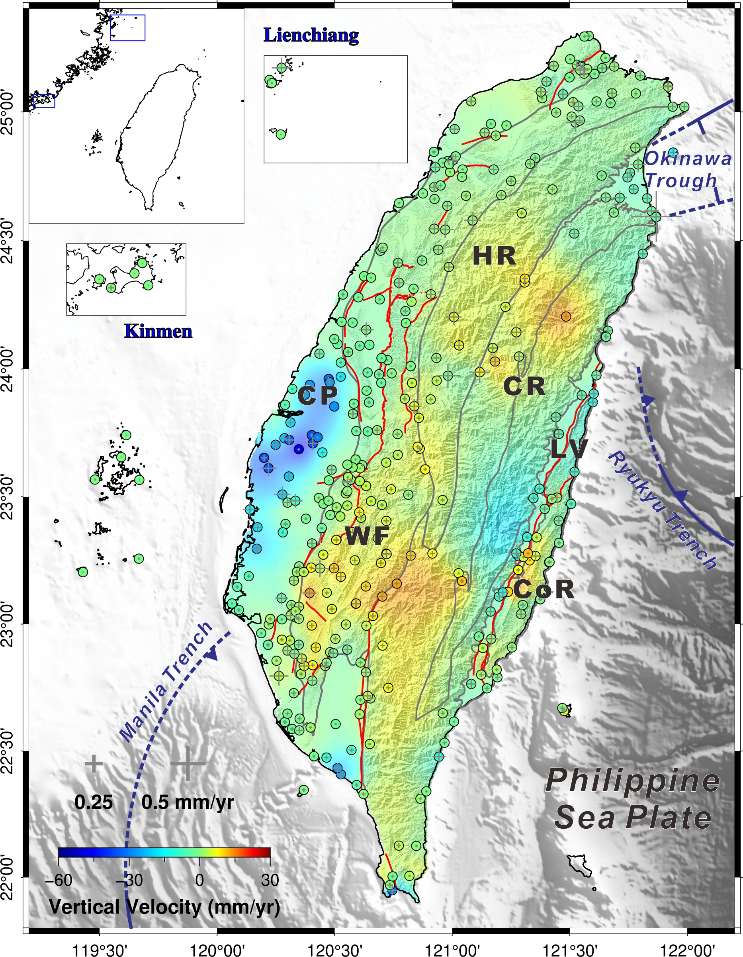
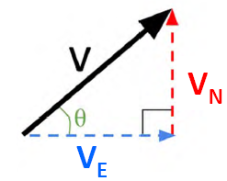
Interseismic motion

Slide 19
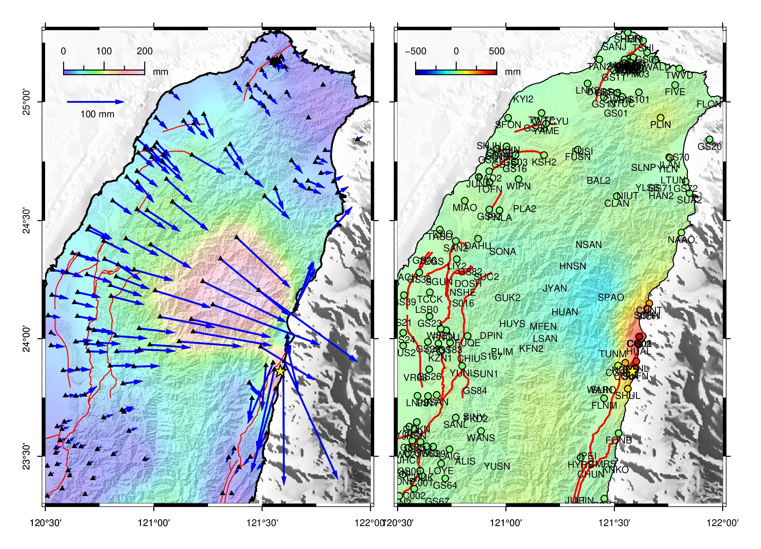
Coseismic displacement

Slide 20
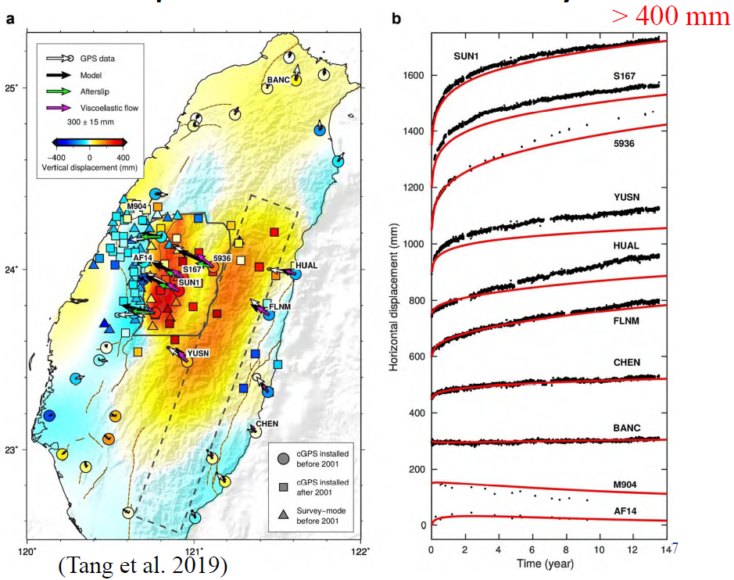
Postseismic displacement

Slide 21
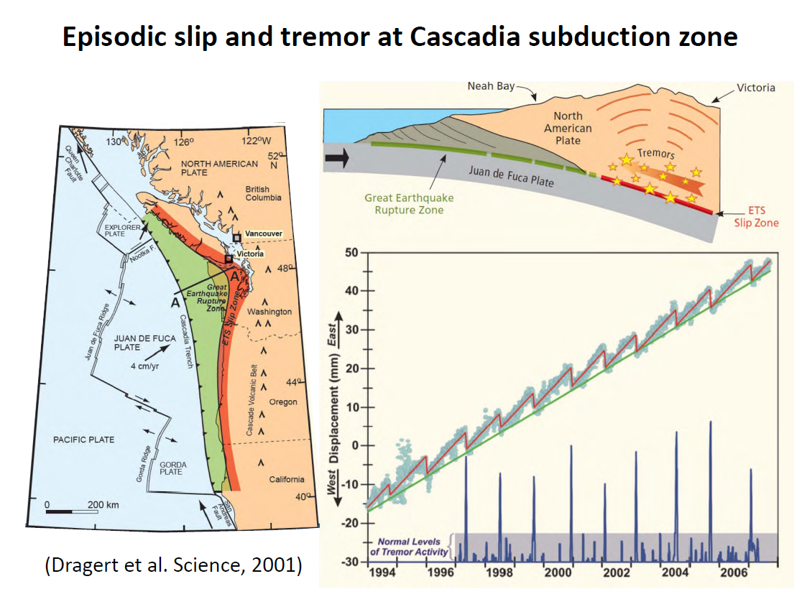
Fault transients

Slide 22
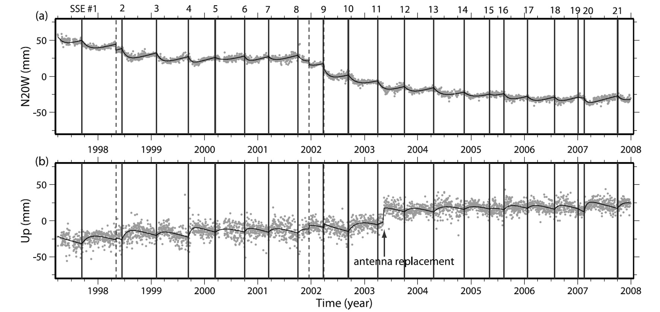
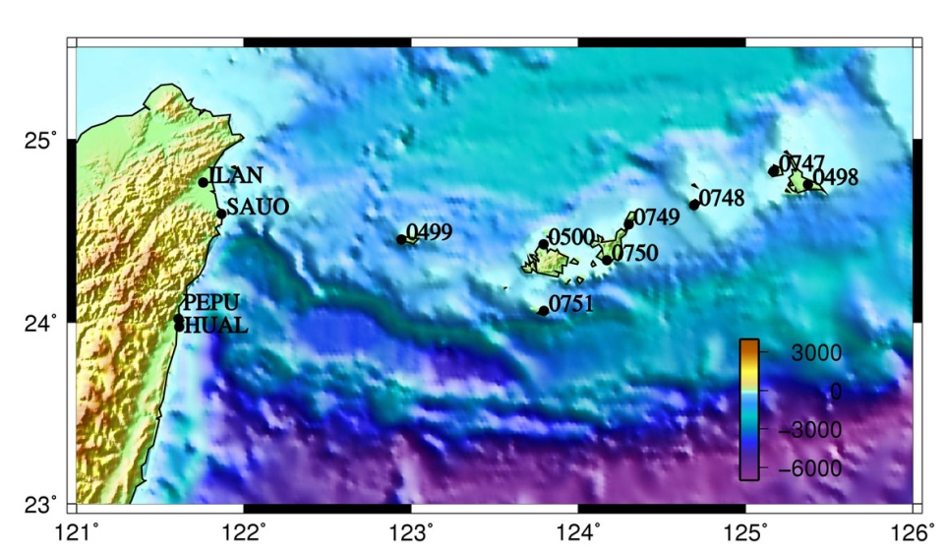
GPS station on Hateruma island
1. Fault slip at a depth range of 20-40 km
2. The slip period is about a month with a release
seismic moment equivalent of M_{w} 6.6
3. The recurrence interval is about 0.5 year
Miyako
Yonaguni
Ishigaki
Iriomote
Hateruma
(Heki and Kataoka, 2008)

Slide 23
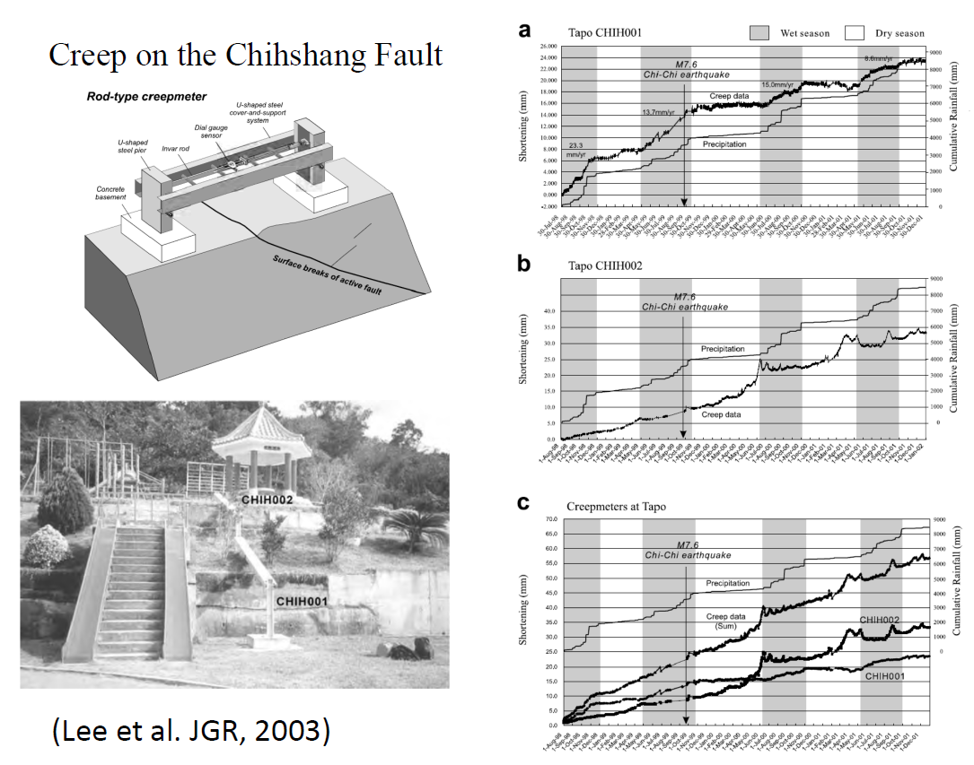
Seasonal motion

Slide 24
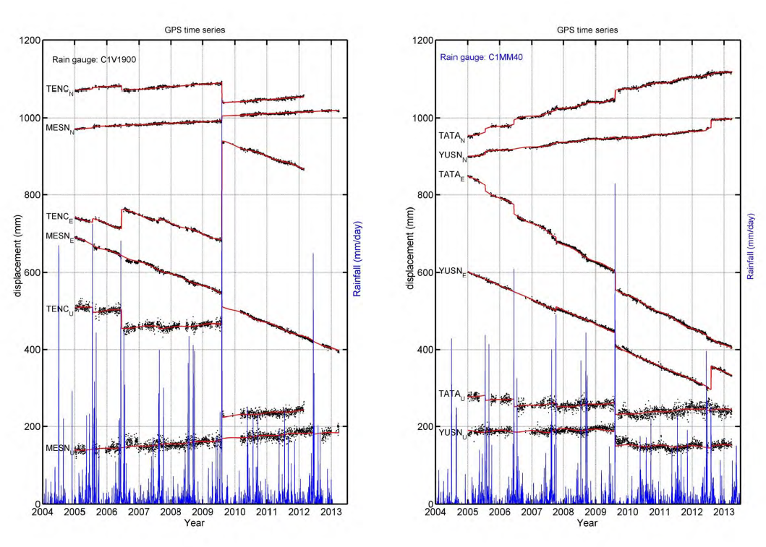
Slow creeping landslides
(Hsu et al., 2014)

Slide 25
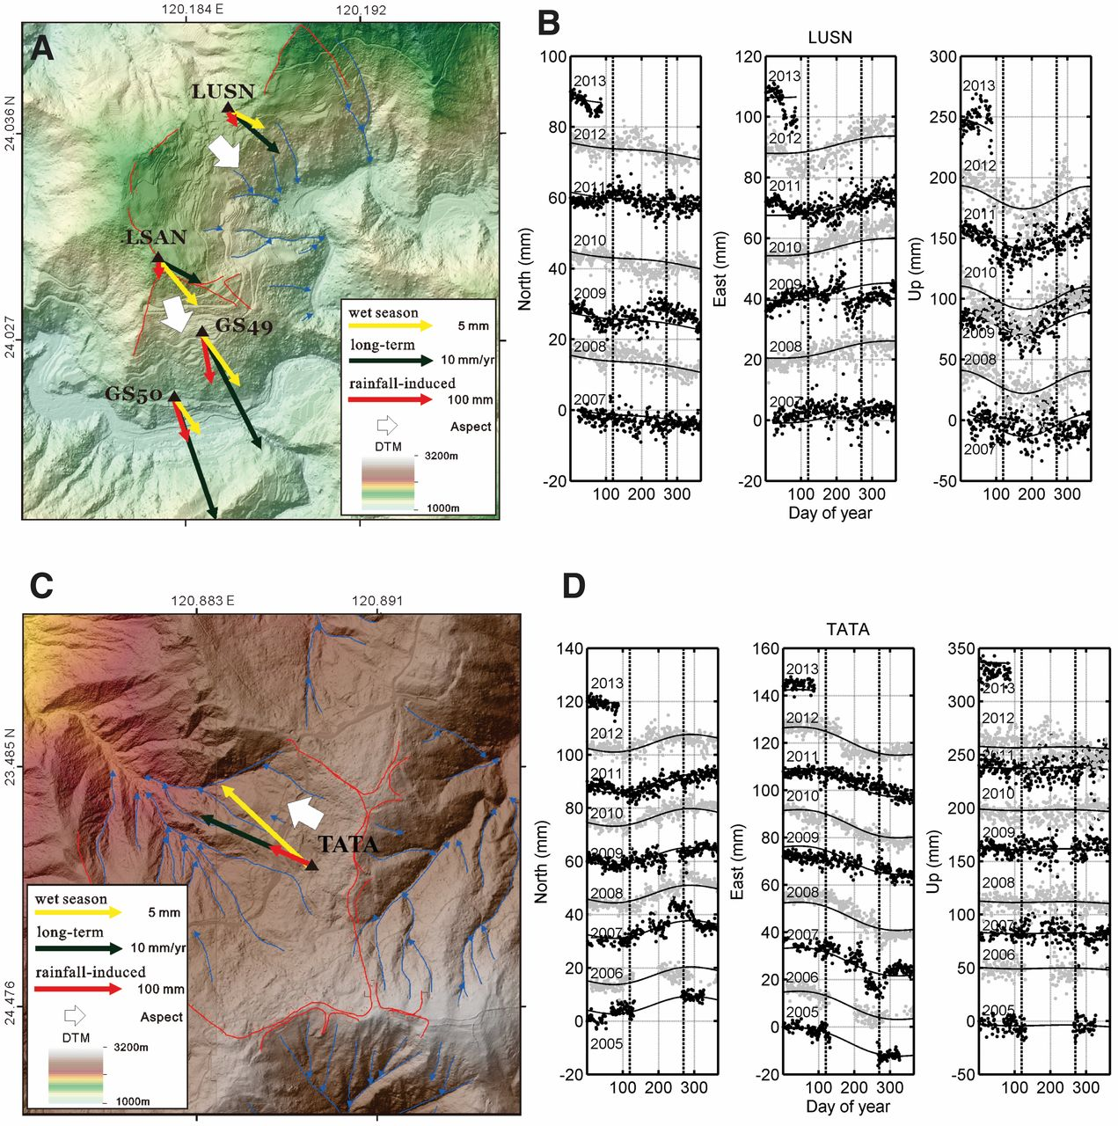
(Hsu et al., 2014)

Slide 26
Environmental change

Slide 27
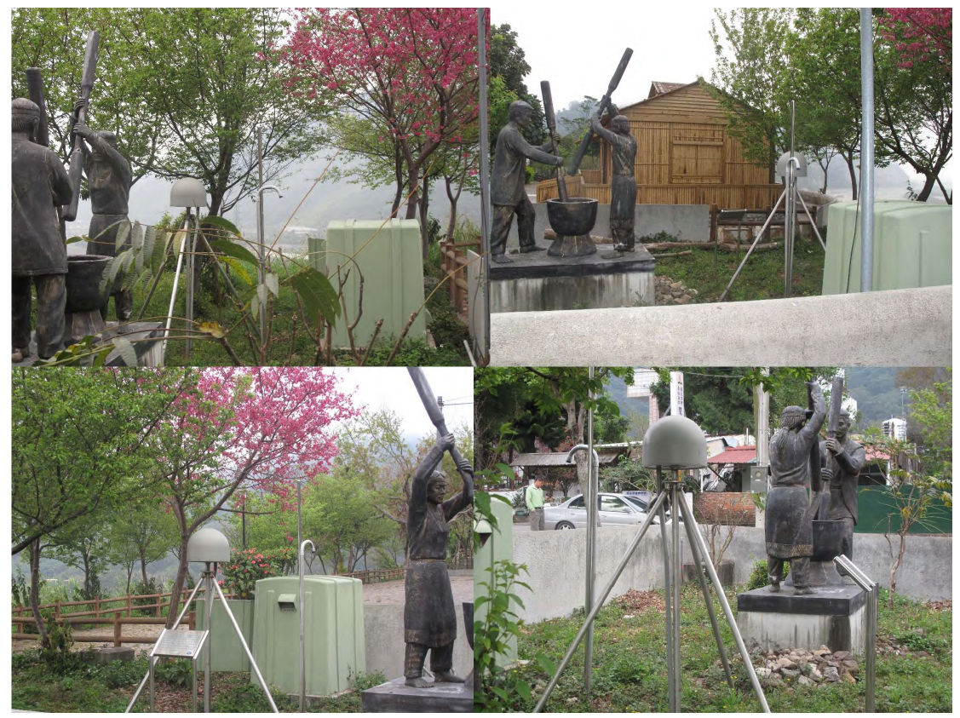

Slide 28
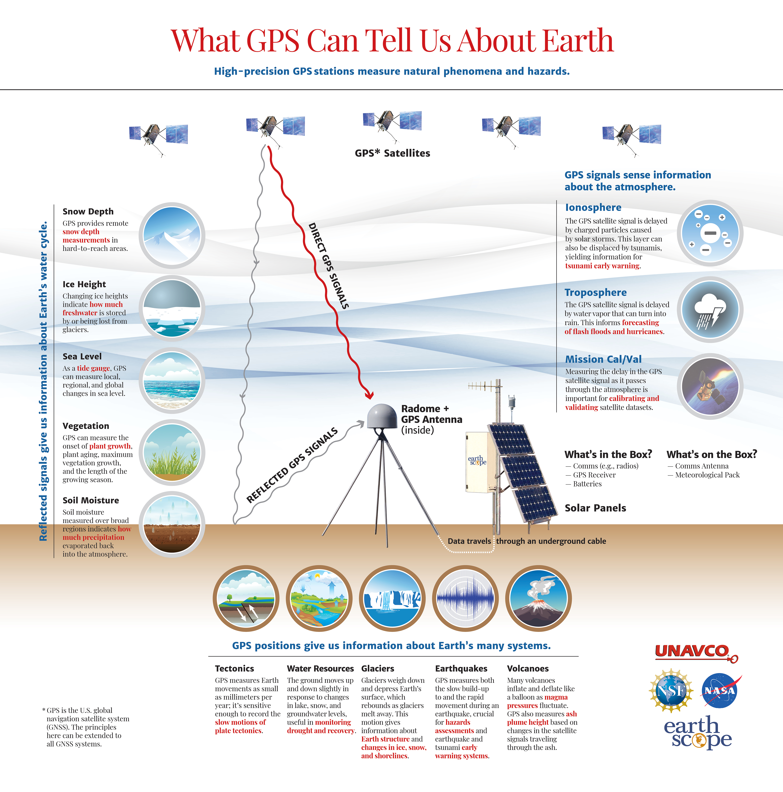

Slide 30
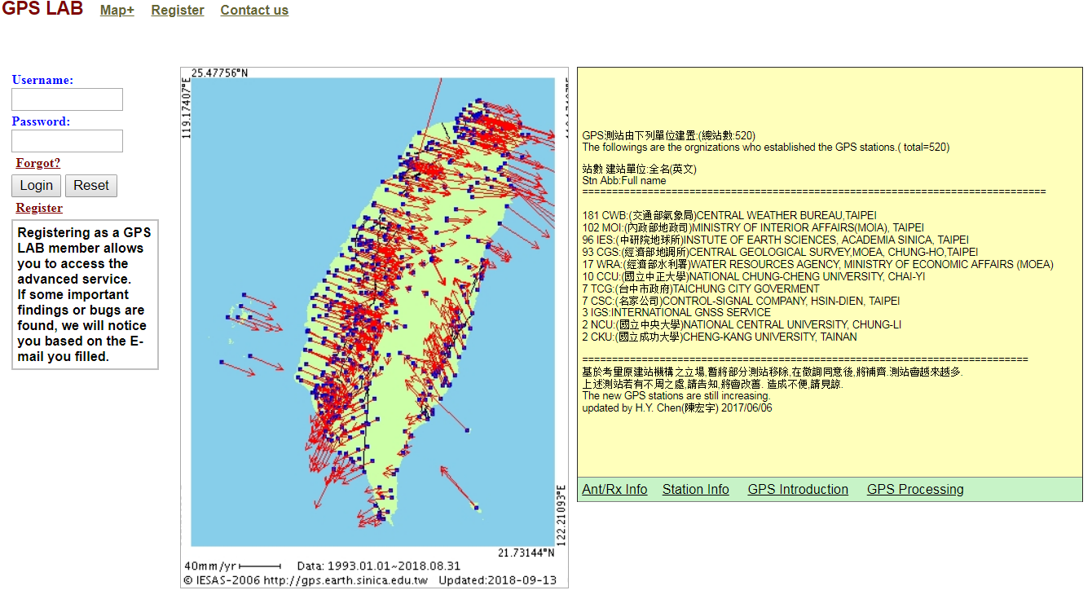
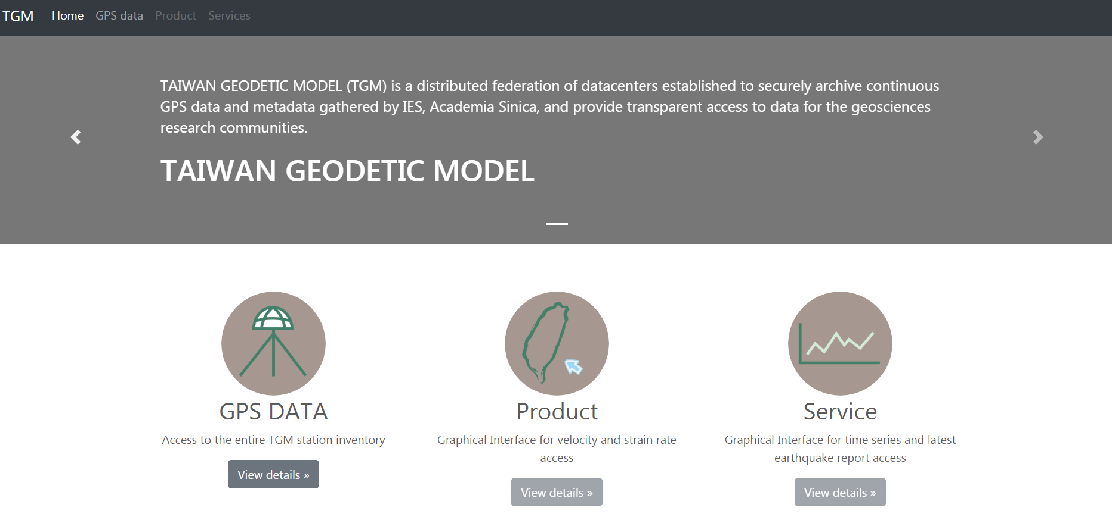
V2
2008 - 2018
V2
2018 - 2022

Slide 31
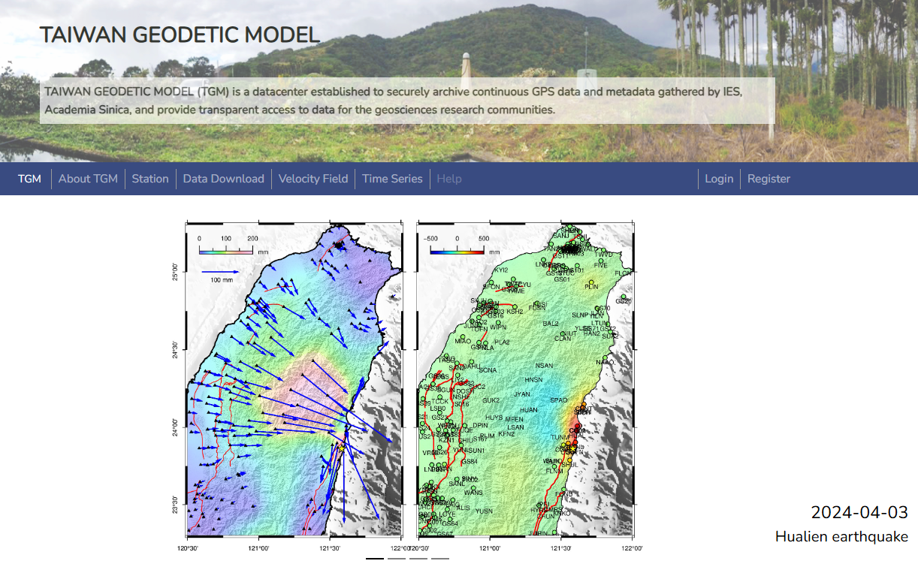




Slide 32
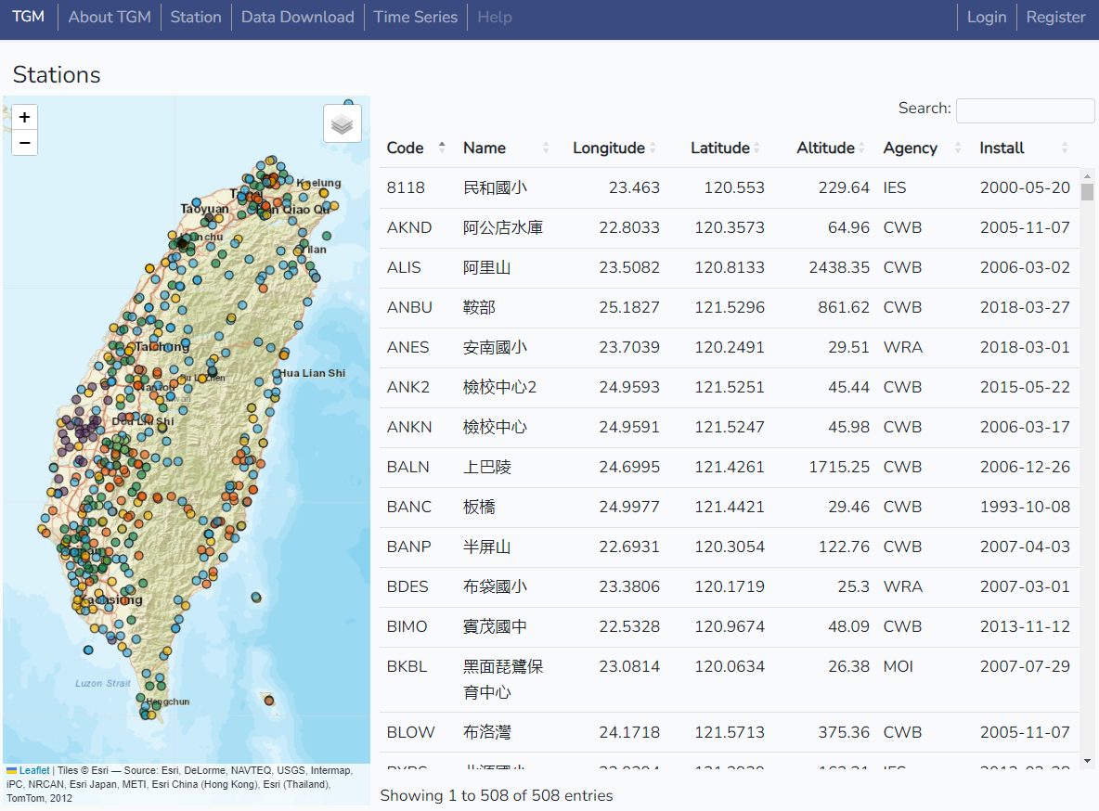
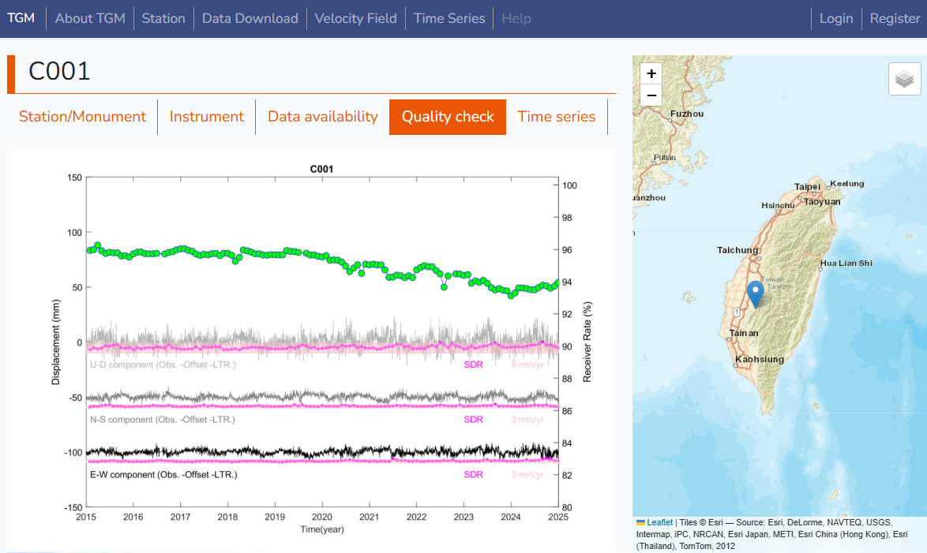

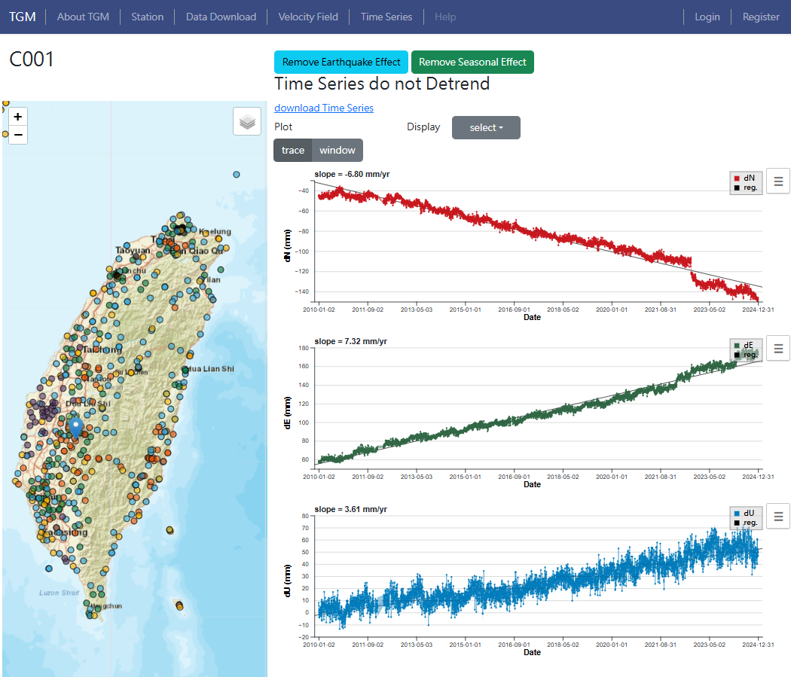
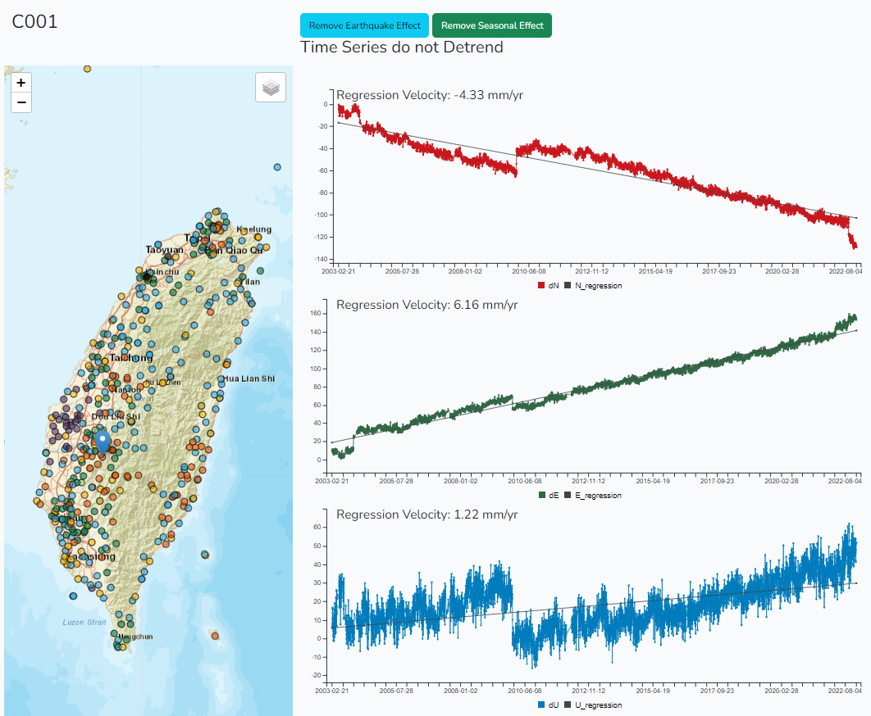

Slide 33
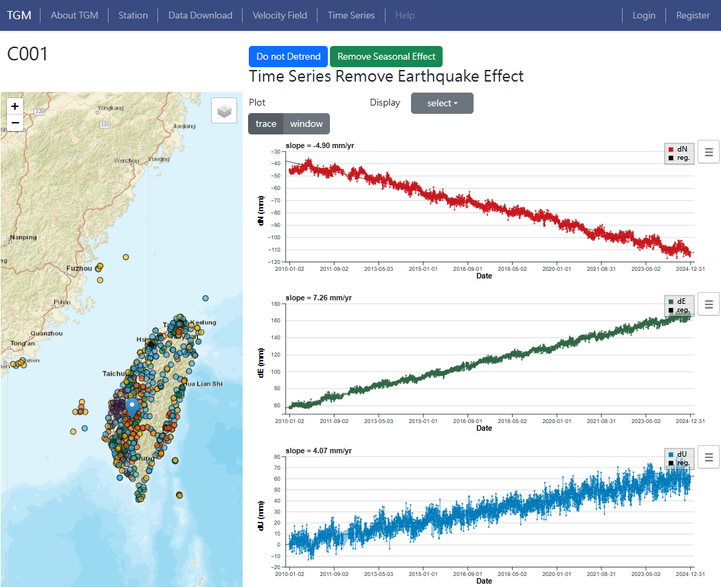

Slide 34
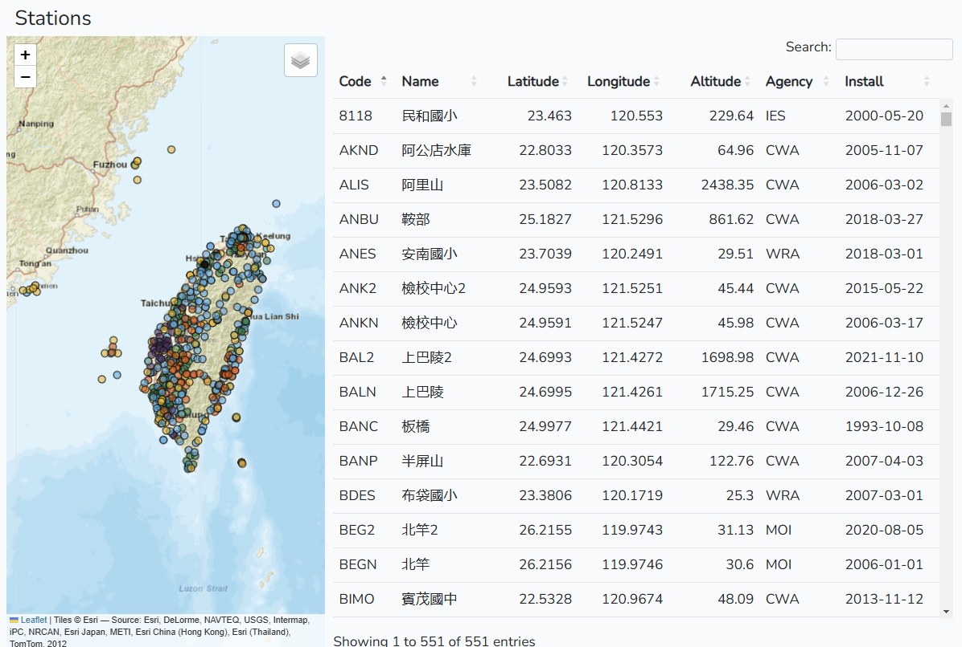

Slide 35
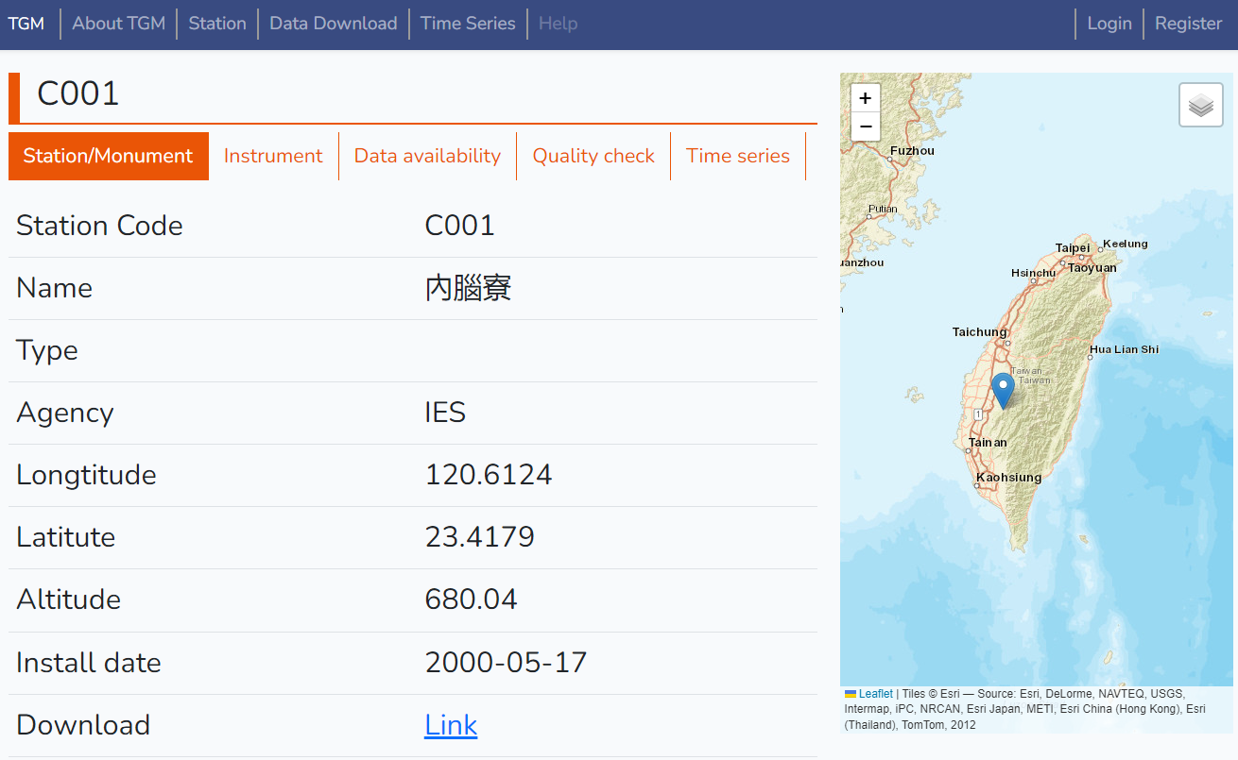



Slide 36


Slide 37



Slide 39



Slide 40




Satellite visibility
The GNSS satellite travel time diagram illustrates the distribution of satellite travel time observed at a station throughout the observation period. In areas with clear sky visibility and minimal obstructions, one would expect a higher count of visible satellites during the observation period.
heavily
vegetated
building
obstruction
Open sky

Slide 41





Slide 42







GNSS各分量標準偏差

Slide 43


Slide 44


Slide 45


Slide 46


Slide 47


Slide 48





Slide 49
https://tgm.earth.sinica.edu.tw/

Slide 50

Typical Raw data formats
Courtesy of Wang, Y.

Slide 51
RINEX file
Receiver Independent Exchange Format
Developed by the Astronomical Institute of the university of Berne in 1989, for the easy exchange of the GPS data
The widely used format of GNSS data collection and data process (RINEX 2.x and RINEX 3.x)
The data can be compressed, or remain in ASCII format
RINEX consists of at least three sub-file type:
Observation data (.o; .obs, .yyo)
Navigation message (.n; .nav; .yyn)
Meteorological data (.m; .met; .yym)

Slide 52




Observation file
The details of rinex header depends on the program and receiver, and person who process data !

Slide 53


C1, Range
L1, Cycle
P2, Range
L2, Cycle
Condition of measurement

Slide 54

Rinex ver. 3
G: GPS
R: GLONASS
E: Galileo
J: QZSS
S: SBAS payload
C: Beidou
RINEX v.3 has been extended to include more observation and frequency!!

Slide 55


Filename
Rinex 2 :
ALGO1600.12O
Rinex 3 : ALGO00CAN_R_20121601000_01D_30S_MO.rnx
ALGO00CAN_R_20121600000_01D_GN.rnx

Slide 56

Common post-processing software
Relative Positioning
Bernese (commercial software)
http://www.bernese.unibe.ch/
GAMIT/GLOBK (MIT)
http://geoweb.mit.edu/gg/
GIPSY-OASIS / GipsyX (JPL)
https://gipsy-oasis.jpl.nasa.gov/
RTKLIB (open source program)
http://www.rtklib.com/

Slide 57
Online GNSS post-processing service
Geoscience Australia
AUSPOS online GPS processing service
http://www.ga.gov.au/bin/gps.pl
NOAA
OPUS: Online Positioning User Service
https://www.ngs.noaa.gov/OPUS/
JPL
The Global Differential GPS (GDGPS) System
http://www.gdgps.net/

Slide 58


https://sideshow.jpl.nasa.gov/post/series.html

Slide 59


Slide 60

http://garner.ucsd.edu/

Slide 61
https://tgm.earth.sinica.edu.tw/

